Slide 1

COLUMBIA ASIA HOSPITAL
SHELDON LUIS DE NORONHA

Slide 2
Data Description
Data Sets
Analysis was done on 2 datasets
Hospital and Patient Related Data:
Data Related to the patient visits such as
Date of admission,
Patient ID,
Department visited,
Patient Satisfaction Score,
Patient Demography,
Patient Wait time.
Doctor Related Data:
Data Related to Doctors such as
Doctor Name,
Treated Patient ID,
Department of Practice,
Apointment Fees per appointment,
Patient Bill Amount per appointment

Slide 3
Data Pre-Processing
Patient Satisfaction Score: Replaced BLANK values with NULL
Patient Gender: Replaced M values with MALE
Patient Gender: Replaced F values with FEMALE
Patient Gender: Replaced NC values with OTHERS

Slide 4
Contents:
01. Introduction
02. About
03. Hospital Stats
Introduction of Topic and Problems being addressed
Details about the hospital
Hospital Operational Data
04. Doctor Stats
05. Patient Stats
Doctor Related Analysis
Patient Related Analysis
06. Stratergies & Improvements
Patient Related Analysis

Slide 5
01. Introduction

Slide 6

Introduction
The Columbia Asia Hospital is a one of the leading hospitals that belonging to the Prestige Hospitals Group.
Aiming to build on the trust and satisfaction of patients

Slide 7

Our Hospital
Columbia Asia Hospital is the leading Hospital in Asia,
providing care to Thousands of its Patients annually with the best doctors in 7 specialized departments.

Slide 8
02. About

Slide 9
Map of Locations
Prestige Hostipals Group
Columbia Asia Hospital
Other Hospitals of the Group

Slide 10

Mission
Vision
To create an Integrated World Class Healthcare System, Fostering, Protecting, Sustaining and Restoring Health through Best in Class Medical Practices and Cutting Edge Technology
Be the preferred choice for the world ' s leading medical professionals and scientific minds

Slide 11

9,200+
9,100+
Key Numbers
509 M$
This is the number of patients we have treated
This is the Total Amount of Revenue generated
This is the total number of
Hospital
Operational Days

Slide 12
Reached Milestones
Patients: 4878
Operational Days: 4855
Revenue: 269M$
2019
2020
Patients: 4338
Operational Days: 4321
Revenue: 240M$

Slide 13
03.
Hospital Stats

Slide 14
Total No. of visited
⁹²¹⁶
Operational days
⁹¹⁷⁶
Revenue Generated
^{509 M$}

Slide 15
Areas We Cover
 | General Practice
 | Cardiology
 | Gastroenterology
 | Neurology
 | Orthopedics
 | Physiotherapy
 | Renal

Slide 16
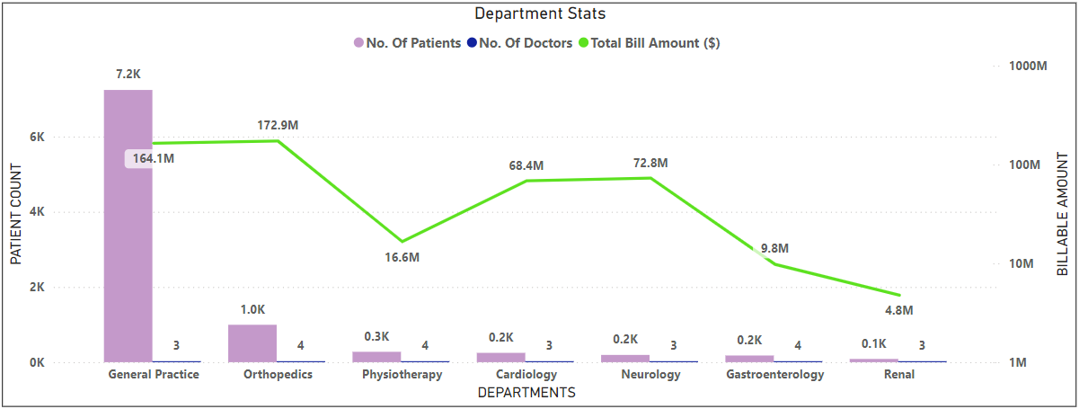
Hospital Analysis
Most Patients (7.2K out of 9.2K) visited General Practice
Most Revenue (172.9M$) was generated by Orthopedics
Least Patients (0.1K ) visited Renal
Least Revenue (4.8M$) was generated by Renal

Slide 17
04.
Doctor Stats

Slide 18
Consultating Doctors
²²
Doctor’s Fees
^{5.3 M$}

Slide 19
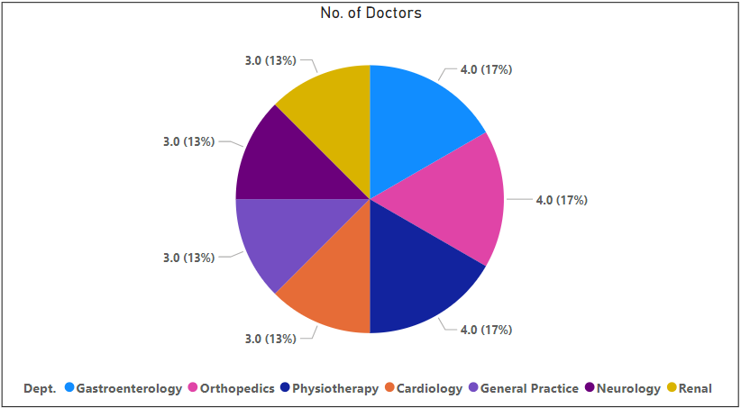
No. of Doctors
The Hospital has a total of 22 doctors/ specialists
Gastroenterology, Orthopedics & Physiotherapy have 4 consulting
Cardiology, General Practice, Neurology & Renal have 3 consulting
Dr. Surya is the only speaclist who consults 3 Departments (Gastroenterology, Orthopedics & Physiotherapy)

Slide 20
05. Patient Stats

Slide 21
Patients that visited
⁹²¹⁶

Slide 22
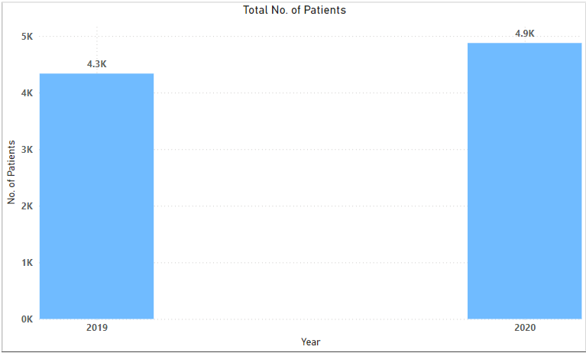
Patients
4.3k Patients in 2019
4.9k Patients in 2020
Boost in the number of patients by 600 from 2019 to 2020

Slide 23
Average Patient Wait Time
^{35 mins 13 secs}

Slide 24
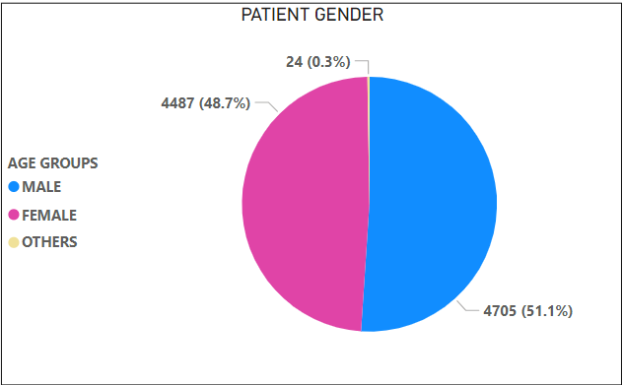
Patient Gender
49% Patients who visit are Female
51% Patients who visit are Male
0.3% Patient gender is not mentioned

Slide 25
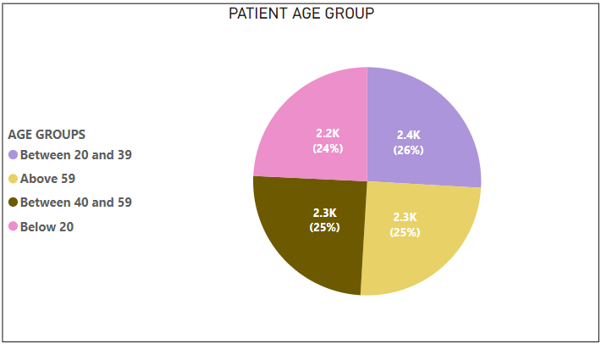
Patient Age Group
2.2K(24%) Patients who visit are less than 20 years of age
2.4K(26%) Patients who visit arein the age group between 20 and 39
2.3K(25%) Patients who visit arein the age group between 40 and 59
2.3K(25%) Patients who visit are Senior Citizens (Above 60 years)

Slide 26

Patient Care
The Hospital to continue its legacy of being the best begins with Patient Satisfaction

Slide 27
Average Patient Satisfaction Score
^{1.36}

Slide 28
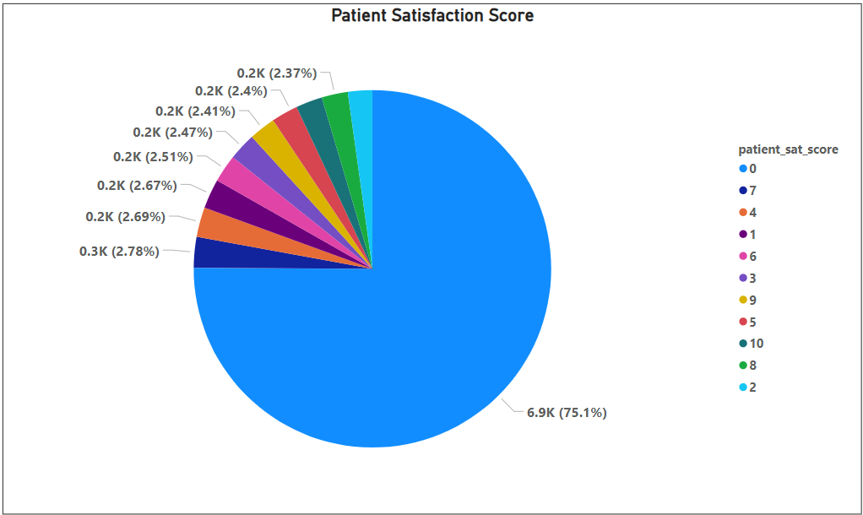
Patient Satisfaction Score
Most Patients 6.9K (75%) were least satisfied by the treatment and services given
Remaining patients 2.3K had given a score from 1 -10 and an average % of 2.7%

Slide 29
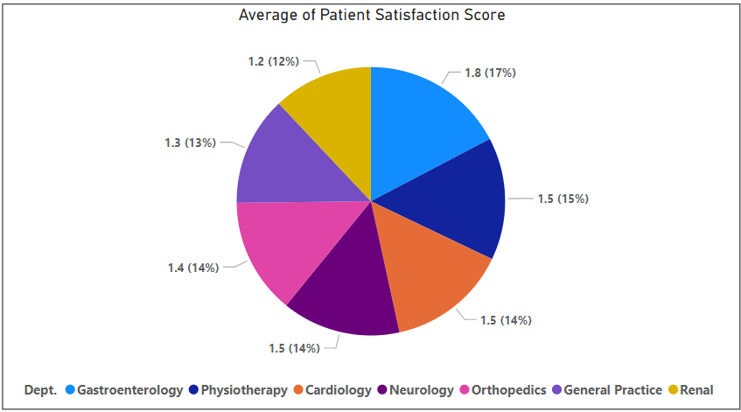
Patient Satisfaction Score
The Average Satisfaction Score of the Hospital (1.36) is bad
Department wise, the Average Satisfaction Score is (approx. 1.5) bad
Gastroenterology having the highest average satisfaction score at 1.8
Renal having the lowest average satisfaction score at 1.2

Slide 30
06. Stratergies & Improvements

Slide 31
IMPROVEMENTS NEEDED
Patient Satisfaction Score
Patient Wait time
Patient Charges
Improve Patient Satisfactory Score
Reduce Patience Wait time
Reduce Patient Charges

Slide 32
Improvement Stratergies
Patient Charges
1
New Hire
2
Providing Patients Discounts based on certain Criteria
Hiring more specialist/ doctors

Slide 33
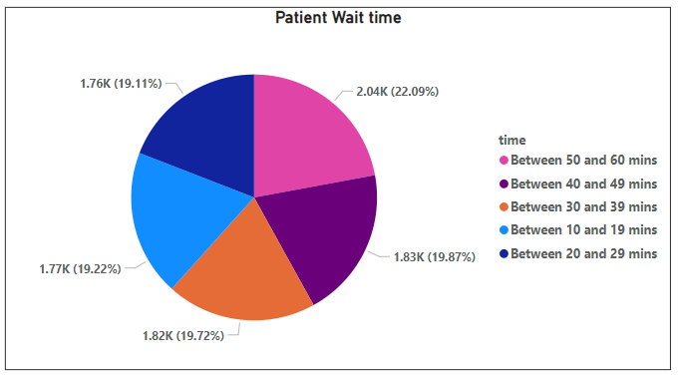
Patient Charges
Patient Charges can drop by either
Providing discounts
Minimizing the total bill by a Percentage
Eligible if:
If the Patient Wait Time exceeds a certain amount of time
If the Amount Charged for Treatment exceeds a certain amount then a percentage of Billing can be rebaited

Slide 34
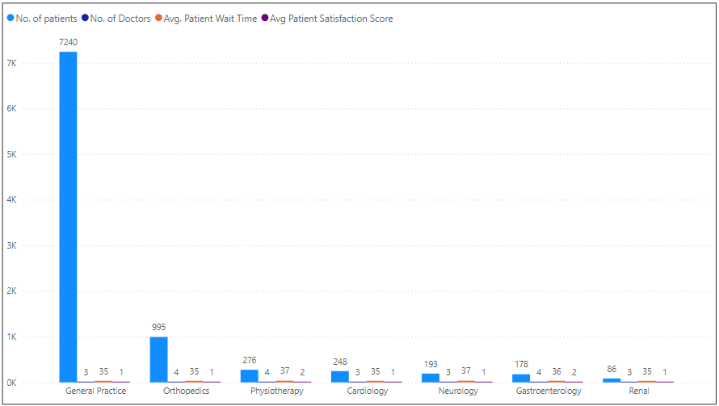
New Hire
Hiring new doctors can boost patient care
(reduce wait times)
After analysing the no. of patients and the avg. wait time, it was found the wait time was comparitively high for Departments Physiotherapy and Neurology
If the budget allowed for 2 new Hires it is should be for Departments Physiotherapy and Neurology

Slide 35
Dashboards
Hospital Dashboard
Doctor Dashboard
Patient Dashboard
Overview of Hospital Stats
Overview of Doctor Stats
Overview of Patient Stats

Slide 36
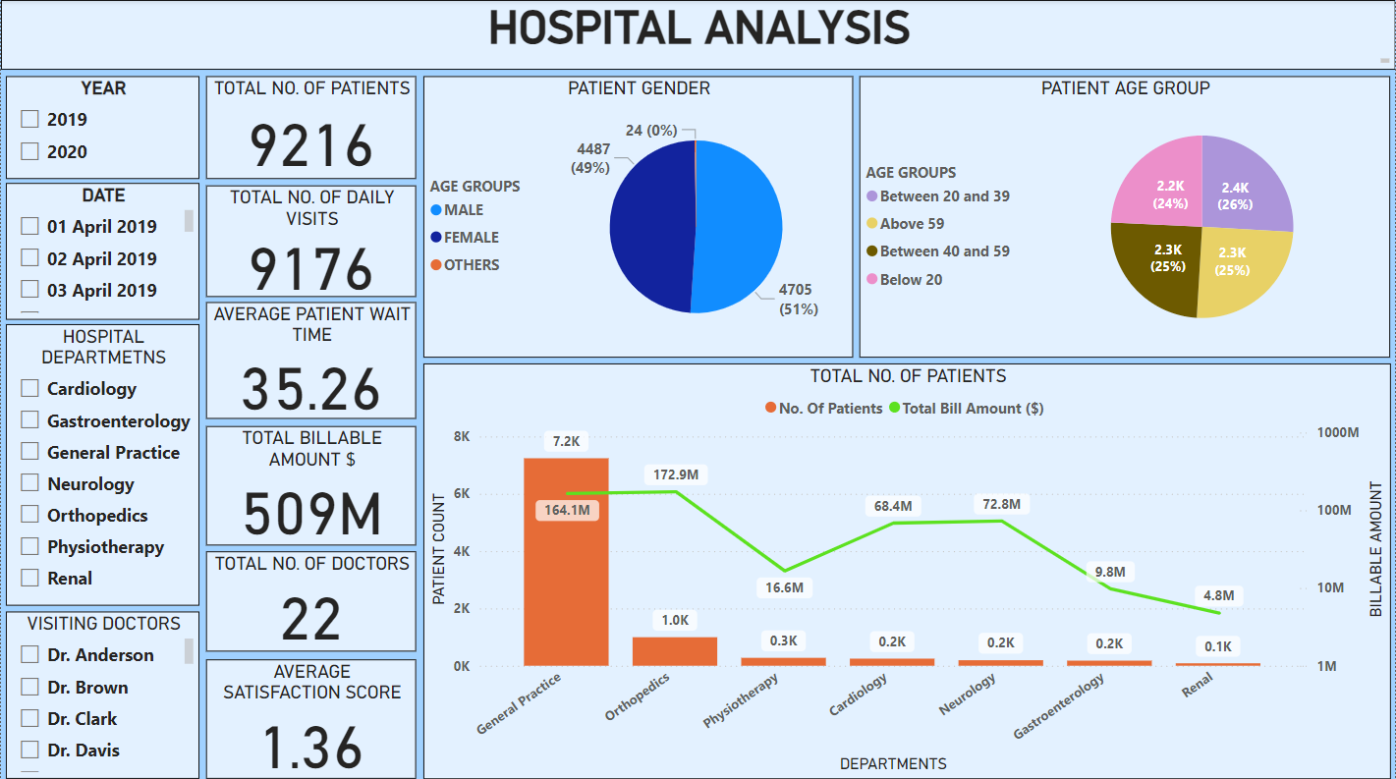
Hospital Dashboard
The Hospital Dashboard gives an overview of the Hospital as a whole
The Dashboard provides info about Departments. Doctors and Patients as well
The Dashboard gives in indepth analysis as well as relation between
Hopital departments,
Visiting Doctors,
their respective Patient related data.

Slide 37
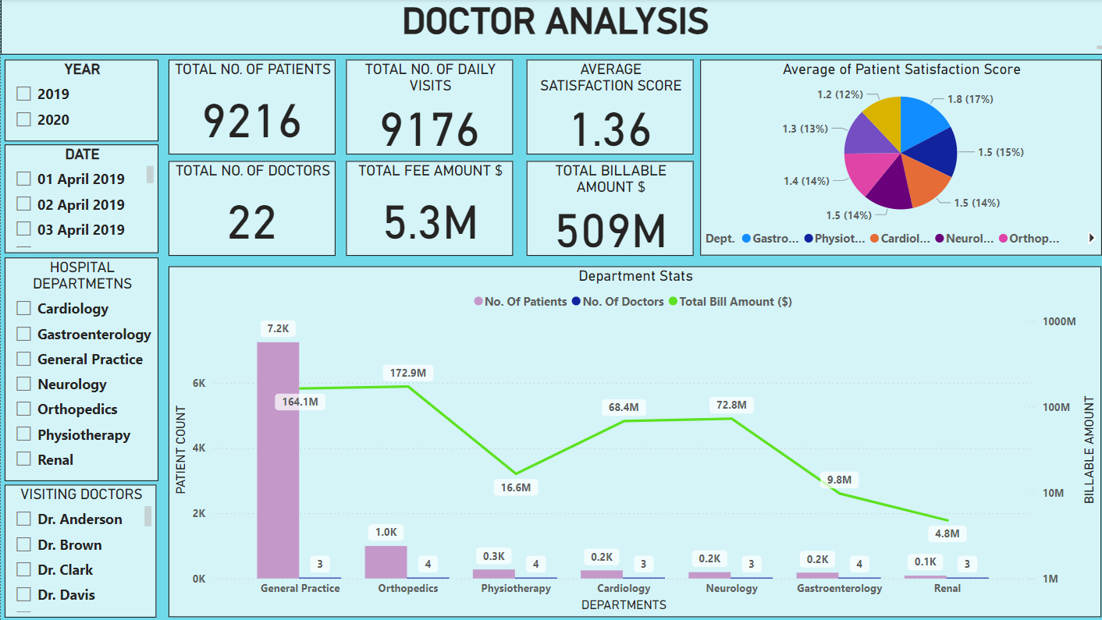
Doctor Dashboard
TheDoctor Dashboard gives an overview of the hospital Doctors
The Dashboard gives in indepth analysis of
Doctors visiting,
the Departments they cater to,
The patient they treat on a daily basis,
The fees they charge
The amont of fees they generate and so on

Slide 38
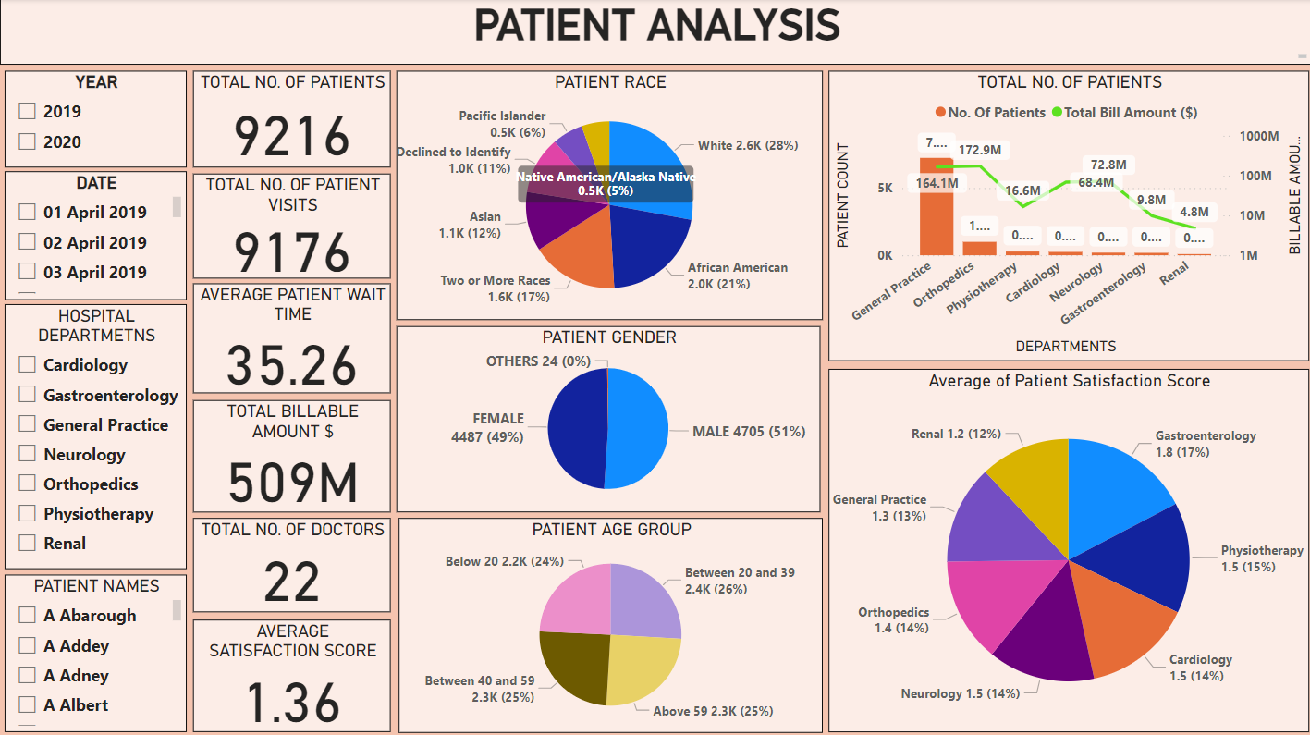
Patient Dashboard
The Patient Dashboard gives an overview of the only the hospital visited patient
The Dashboard gives in indepth analysis of
patients who visited,
the Departments they have visited,
age group they below to, their race,
their gender,
satisfaction score they have given and so on

Slide 39


Testimonials
“The Cardiology Department is a life saver being efficient at their execution”
“The General Practice Department at Columbia Asia Hospital was swift and effient in their care.”
John Doe
Jenna Long
“Despite being lots of pain, the treatment at Gastroentrology Department was effective and provided a quick relief”
“The Physiotherapy Department at Columbia Asia Hospital has the best diagnosis and treatments.”
Helena Cruz
Richard Roe

Slide 40
Prestige Hospitals Group Awards
Columbia Asia
Mercury
Meteor
Neptune
2020
2019
2018
2017

Slide 41



Our Hero
Dr. Smith
Has provided aid and relief to 6,000 Patients in the General Practice Department
Dr. Miller
Well known for managing a great deal of complicated issues in Pysiotheraphy Department.
Renowned for exact diagnosis.
Dr. Surya
Multi Specialist Surgeon, aided in managing complicated issues in Gaestroentrology, Orthopedics & Physiotherapy Departments

Slide 42
Conclusion
The hospital has treated 9.2k Patients.
The hospital caters to all patient age groups and races.
The hospital has 22 doctors and 7 Departments.
The hospital has genetated Revenue of 509M$.
The average patient wait time is 35.26 mins which needs to be reduced.
The average patient Satisfaction Score is 1.36 and needs immideate improvement.

Slide 43

Thank You

